Slide 1
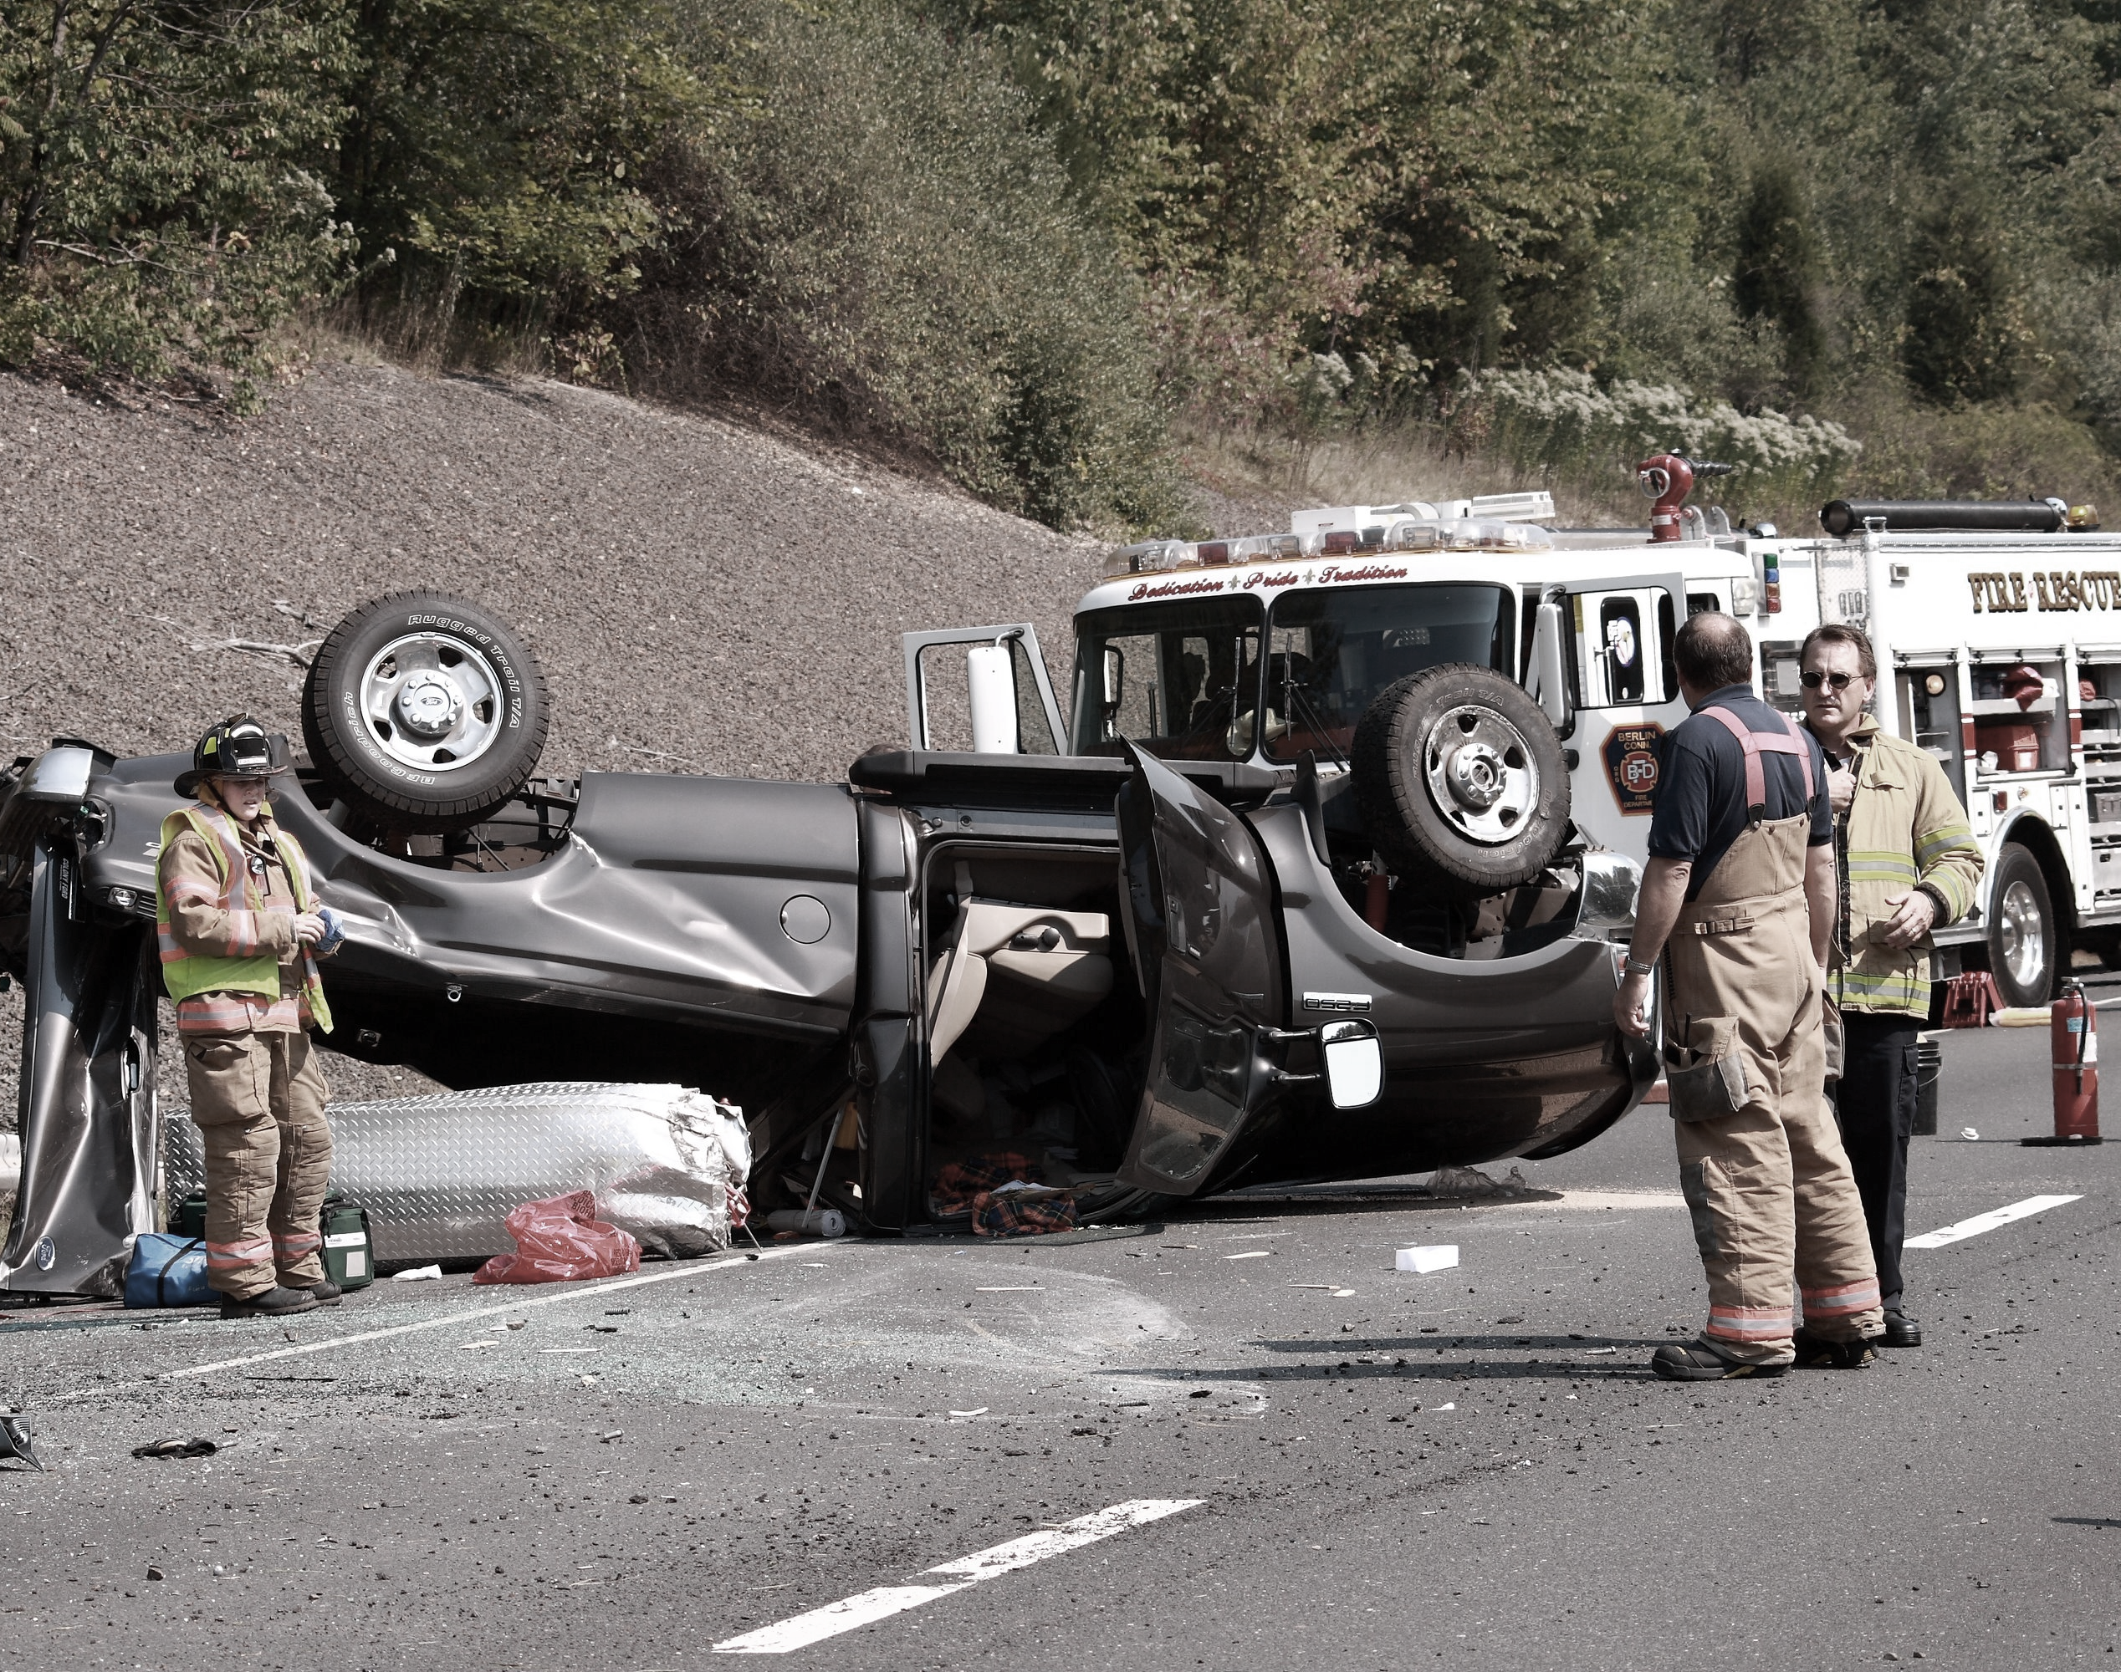
VEHICLE COLLISION REPORT
Presented by ProVision Consult

Slide 2

Meet the Team...
ProVision Consult
Juliet Fafali Kukuia
Samuel Amartey Armah
Nana Dansoa Bediako
Aisha Hussein Kanyiti
Esther Dankwah Affum
Founder
Co-Founder
Database Administrator
Data Analyst, Team Lead
Technical Support Specialist

Slide 3
OVERVIEW
Introduction
Key Objectives
Analysis insights
Recommendations
This Photo by Unknown Author is licensed under CC BY-NC-ND

Slide 4
INTRODUCTION
Date and time of the crash
Vehicle Types and Categories
Crash contributing Factor
Location (street, intersection, borough, etc.)
Casualties
What is this data about?

Slide 5
INTRODUCTION-cont’d
This form collects information about what happened, what may have caused the accident, and the impact (injuries, fatalities, etc.).
The data is stored in a system that helps track crash trends and improve road safety.
Police officers fill out a form (MV-104AN) every time a crash happens.
Where did this data come from?

Slide 6
INTRODUCTION-cont’d
Identify high-risk areas where crashes happen frequently.
Analyze why crashes happen—speeding, drunk driving, or bad weather?
Supports traffic management strategies, such as Vision Zero, which aims to reduce traffic deaths to zero.
Why is this data important?

Slide 7
Objectives
Where are most accidents happening?
What time of day do crashes peak?
Which vehicle category are most involved in crashes?
What are the most common causes of crashes?
How many crashes result in injuries or deaths?
This Photo by Unknown Author is licensed under CC BY-NC-ND

Slide 8

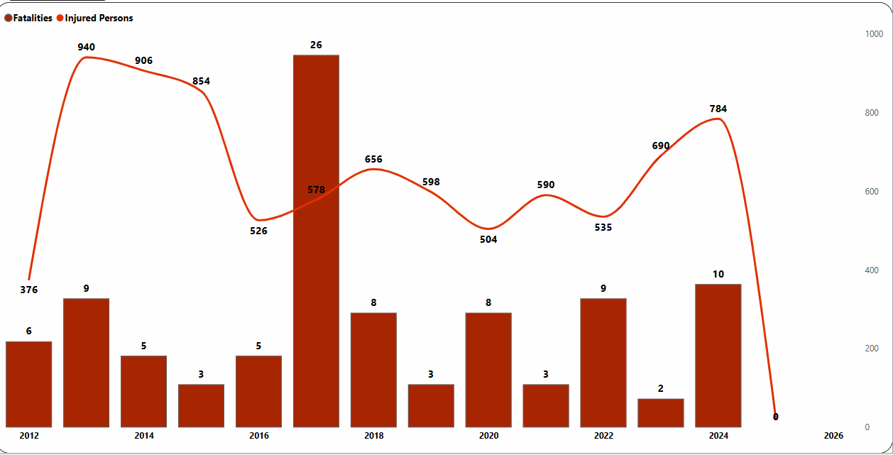
Data insights
Total Casualties Over Time

Slide 9
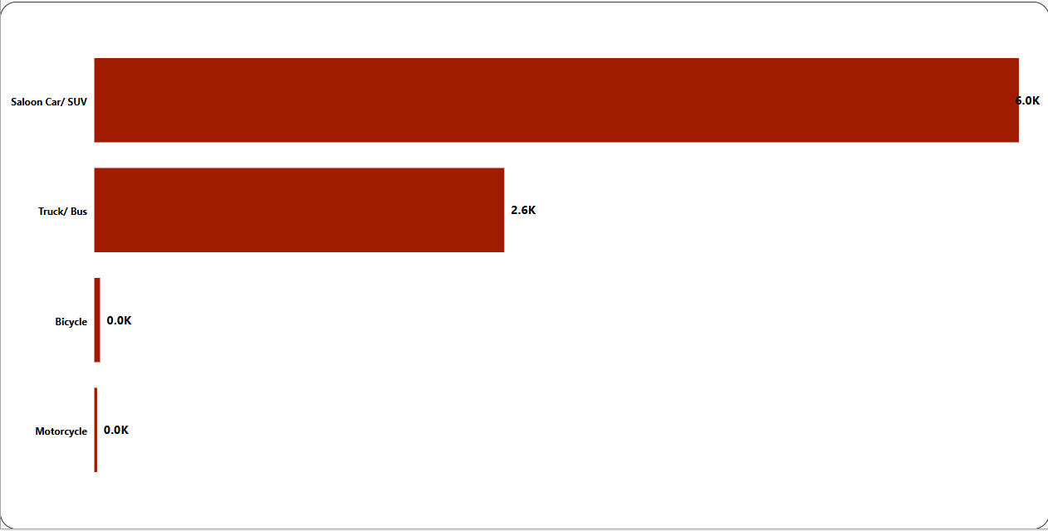
Data insights
Casualties By Vehicle Category

Slide 10
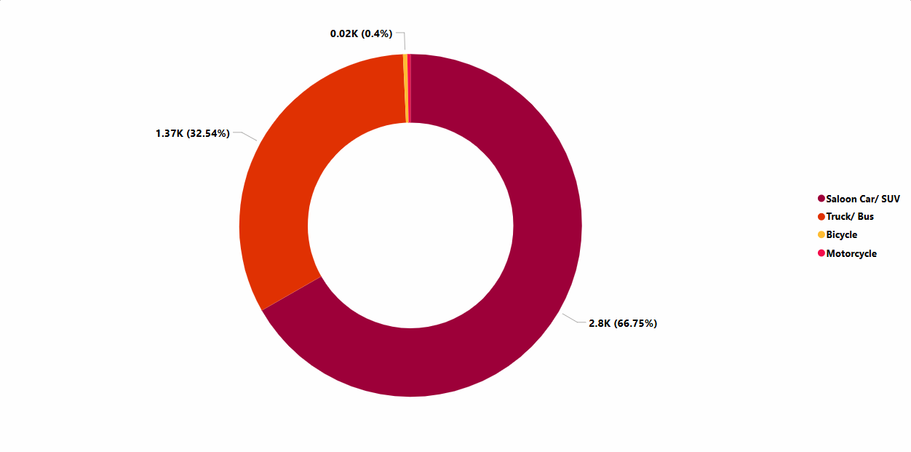
Data insights
Vehicle Category

Slide 11
Key Findings
Most crashes happen during the hours of 12am & 5pm.
Fewer fatalities as compared to the number of injured persons.
Brooklyn recorded the highest number of cases.
Saloon Cars/ SUV recorded the highest number of crashes

Slide 12
Top Contributing Factors
Driver’s Inattention
Alcohol Involvement
Unsafe speed
Disregard for Traffic Control

Slide 13
Key Limitations
1,124 cases out of 4,198 total recorded cases had unspecified contributing factors, accounting for 26.8% of total cases.
Limited Geographic Scope(Inability to access whether certain crash patterns are unique to NYC or part of a broader regional trend)
Limited applicability of insights to statewide or national traffic safety
This Photo by Unknown Author is licensed under CC BY-NC-ND

Slide 14
Recommendations
Expanding dataset to include more Boroughs for a more comprehensive view of traffic collisions
Improve road safety signs & signals in high-risk locations.
Implement more speed cameras in accident-prone areas.
Increase traffic enforcement during peak hours. The city can improve traffic laws (e.g., adding speed cameras in high-risk zones).
More pedestrian crossings, traffic lights, or bike lanes can be added to prevent accidents.
Emergency response teams can be better prepared for accident-prone areas.
This Photo by Unknown Author is licensed under CC BY-NC-ND

Slide 15
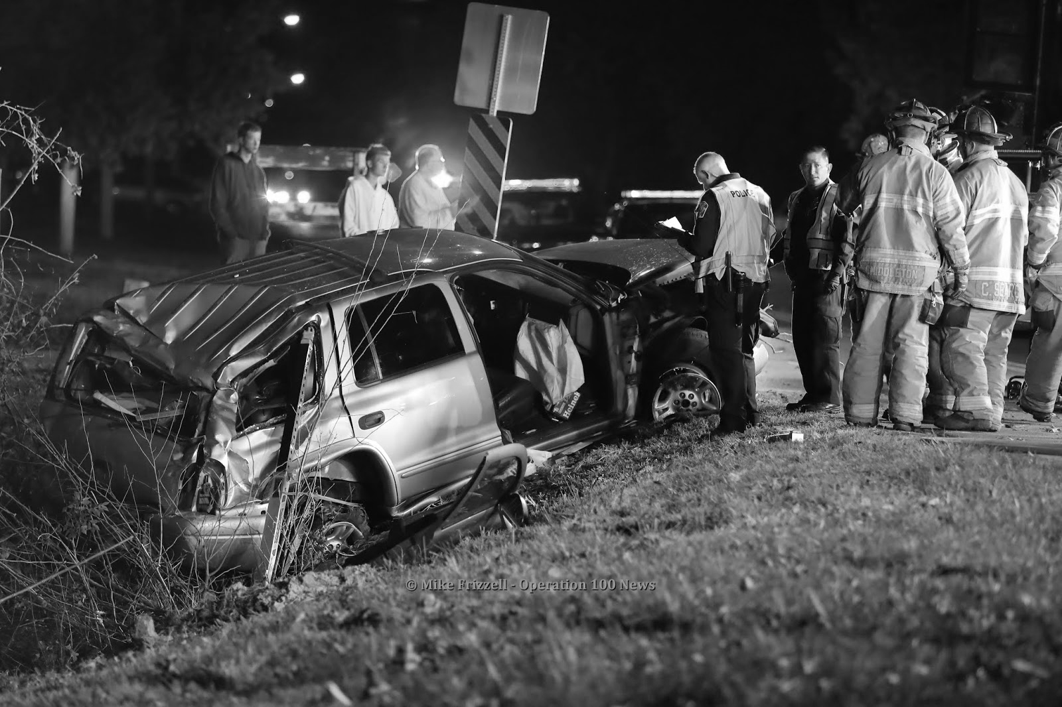

THANK YOU!!!
Any Questions?
Contact via email: provisionconsult@gmail.com

